Slide 1

Accelerating iterative relational algebra operations
09/12/2023
oneAPI Hackathon: CUDA to SYCL Migration

Slide 2



Team Members
Ahmedur Rahman Shovon
Thomas Gilray
Sidharth Kumar
Ph.D. Student (CS) University of Illinois Chicago Email: ashov@uic.edu
Assistant Professor (CS) University of Alabama at Birmingham Email: gilray@uab.edu
Assistant Professor (CS) University of Illinois Chicago Email: sidharth@uic.edu

Slide 3

Inspiration
Iterative relational algebra (RA kernels in a fixed-point loop) enables bottom-up logic programming languages such as Datalog which can be implemented using relational algebra primitives (e.g., projections, reorderings, and joins)
While much has explored standalone RA operations on the GPU, relatively less work focuses on iterative RA, which exposes new challenges (e.g., deduplication and memory management)

Slide 4
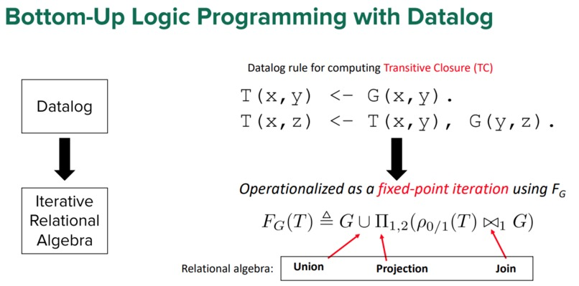
Transitive Closure Computation using Iterative Relational Algebra

Slide 5

What it does
Developed a GPU-based hash-join implementation, leveraging
a novel open-addressing-based hash table implementation
operator fusing to optimize memory access
two variant implementations of deduplication
Implemented transitive closure using our hash-join-based CUDA library and compared its performance against cuDF (GPU-based) and Souffle (CPU-based)

Slide 6

Environment and Datasets
Benchmarked our experiments on the ThetaGPU supercomputer of Argonne National lab using a single nVidia A100 GPU
CUDA kernel size: 3456 X 512
CUDA version: 11.4
Souffle version: 2.3 with 128 threads
Datasets: Stanford large network dataset collection, SuiteSparse matrix collection, and road network real datasets collection

Slide 7

Challenges we ran into
Unlike C++, CUDA lacks efficient data structures, limiting our implementation's capabilities
The available VRAM of a single GPU imposes constraints on our implementation's scalability
Debugging kernel code posed significant challenges, turning it into a nightmarish experience

Slide 8

What we learned
Efficient memory management is crucial for successful CUDA implementations
Handling the indeterministic result size per iteration in Iterative RA operations requires careful consideration
While low-level GPU code allows optimization opportunities, it demands considerable time and effort compared to using off-the-shelf libraries like cuDF

Slide 9

Accomplishments
Our hash-join-based transitive closure computation shows favorable results against both cuDF and Souffle, with gains up to 10.8x against cuDF and 3.9x against Souffle

Slide 10

Publications
Shovon, A. R., Gilray, T., Micinski, K., & Kumar, S. (2023). Towards Iterative Relational Algebra on the {GPU}. In 2023 USENIX Annual Technical Conference (USENIX ATC 23) (pp. 1009-1016).
Shovon, A. R., Dyken, L. R., Green, O., Gilray, T., & Kumar, S. (2022, November). Accelerating Datalog applications with cuDF. In 2022 IEEE/ACM Workshop on Irregular Applications: Architectures and Algorithms (IA3) (pp. 41-45). IEEE.

Slide 11

Project Repository
Transitive closure computation using CUDA: https://github.com/harp-lab/usenixatc23
Transitive closure computation using SYCL: https://github.com/arsho/tc

Slide 12
Porting TC computation CUDA implementation
Clean
Clean CUDA Project
Install
Install SYCLomatic
Convert
Convert CUDA code to SYCL
Check
Check the SYCL code and modify if necessary
Execute
Run in Intel Dev Cloud

Slide 13
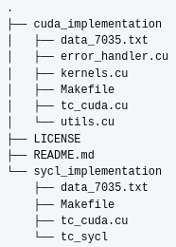
Clean CUDA Project
Our CUDA code has multiple files and a Makefile that has auxilary commands
To port the CUDA project to SYCL first we cleaned the CUDA project
We made one file that has CUDA code, simplified the Makefile, and kept one test dataset
The folder sycl_implementation has the single cuda file

Slide 14
Install SYCLomatic
Open a terminal and download SYCLomatic release: cd ~/ mkdir syclomatic cd syclomatic wget https://github.com/oneapi-src/SYCLomatic/releases/download/20230725/linux_release.tgz tar -xvf linux_release.tgz
Add the bin path to .zshrc: export PATH="~/syclomatic/bin:$PATH"
Check c2s version: c2s --version

Slide 15
Convert CUDA code to SYCL
Convert the CUDA code to SYCL and create a directory to store the SYCL code: intercept-build make c2s -p compile_commands.json --out-root tc_sycl
Copy sample dataset to the SYCL code directory and create a compressed file: cp data_5.txt data_7035.txt tc_sycl tar -cvf tc_sycl.tgz tc_sycl

Slide 16
Check SYCL Converted Code
We had error in converted SYCL code using SYCLomatic 20230725 release. In converted SYCL code, we needed to replace std::reducet to std::reduce
This error did not appear when we used SYCLomatic 20230830 release
While converting Thrust's exclusive scan API, the SYCLomatic code was generating errors which was resolved by removing (decltype(offset)::value_type) from the following line: std::exclusive_scan(oneapi::dpl::execution::make_device_policy(q_ct1), offset, offset + t_delta_rows, offset, 0);
For operator function, we needed to add const in the signature: bool operator()(const Entity &lhs, const Entity &rhs) const

Slide 17
Execute in Intel Dev Cloud
Upload the SYCL code folder to Intel Dev Cloud: scp tc_sycl.tgz idc:~/
Connect to Intel Dev Cloud, start an interactive session, load the modules: ssh idc srun --pty bash source /opt/intel/oneapi/setvars.sh
Execute the SYCL code: tar -xvf tc_sycl.tgz cd tc_sycl icpx -fsycl *.cpp

Slide 18
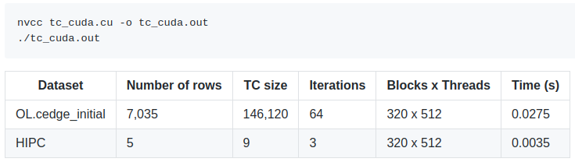
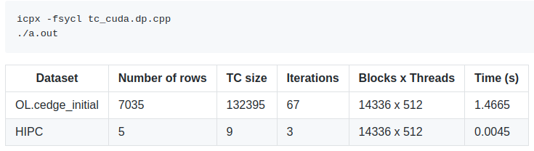
Result comparison: CUDA and SYCL
CUDA results
SYCLomatic generated SYCL results

Slide 19

Status
We ported the CUDA transitive closure computation code to SYCL using SYCLomatic
We needed to manually change some of the converted code to resolve compilation error
The SYCL results are correct for small datasets but incorrect for larger ones
As SYCL supports many standard data structures, we decided to implement SYCL implementation from scratch removing the overheads of Thrust APIS

Slide 20

Future Direction
Implement transitive closure computation using SYCL from scratch
Compare the TC computation with CUDA, cuDF, and Souffle on single GPU
Extend the computation to use multiGPU environment on intel GPU targeting the Aurora supercomputer

Slide 21

Feedback
Examples on dynamic data structure implementations using SYCL would be helpful
Automated generation of additional comments on ported code can explain the converted code

Slide 22
Thank You

